Slide 1

SwissAnaesthesia
2021
ECMO salvage in critically ill obstetric patients
PD Dr. med. P. Vuilleumier, Luzern
Annual Congress
Palexpo Genève, 28 – 30 Oct. 2021

Slide 2
SwissAnaesthesia
2021
Disclosure/Conflict of Interest
None
Annual Congress
Palexpo Genève, 28 – 30 Oct. 2021

Slide 3
My disclosures regarding ECMO
This is my obstetric anesthetist’s viewpoint
Personal experience with ECMO in parturients: N=3
The survival rate of parturent ECMO patients i have treated: N=0
Nonentheless I would again place an ECMO in a parturient patient

Slide 4

Agenda
A somehow personal introduction
Why does this topic matter now ?
How strong is the evidence
Lessons learned and recomendations to keep in mind

Slide 5
MBRRACE-UK 2020

Slide 6

Patient 1:
  Intrauterine fetal death in 32 week of pregancy
  intrahospital rescusitation with ECLS
  Septic schock, DIC
  multiorgan failure and death in the ICU approx. 12h after surgery
Patient 2:
  37 week of pregnancy, on street collapse with immediate CPR,
  CPR during ambulance transport
  massive pulmonary embolism
  ECLS in ER
  Emergency cesaeran hysterectomy with massive diffuse bleeding
  massive transfusion protocol with consequent death in the OR
Patient 3:
  Amniotic fluid embolism during emergency-CS
  rescucitation, hysterectomy
  massive transfusion
  stabilization of DIC
  transfer to ECMO
  Ischemic braindeath after 12 days later in the ICU

Slide 7
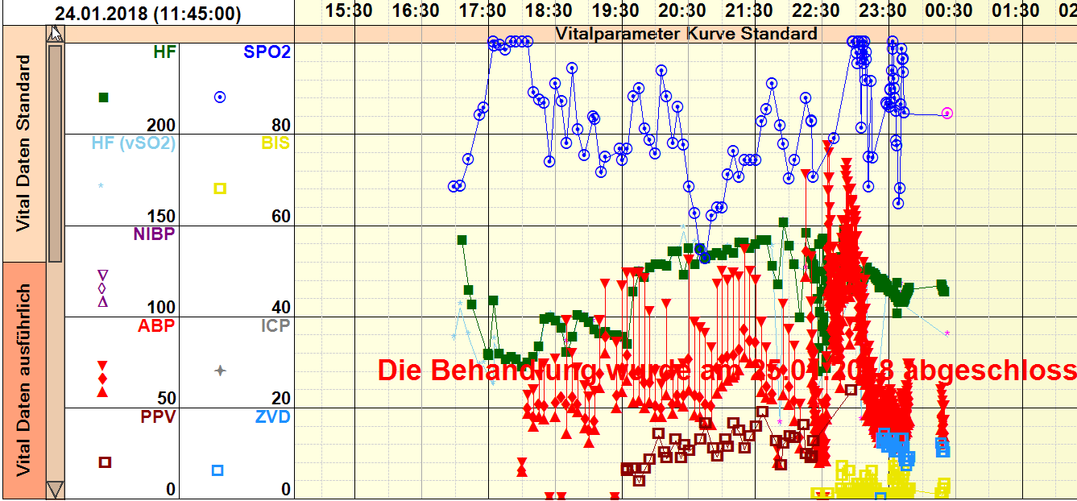
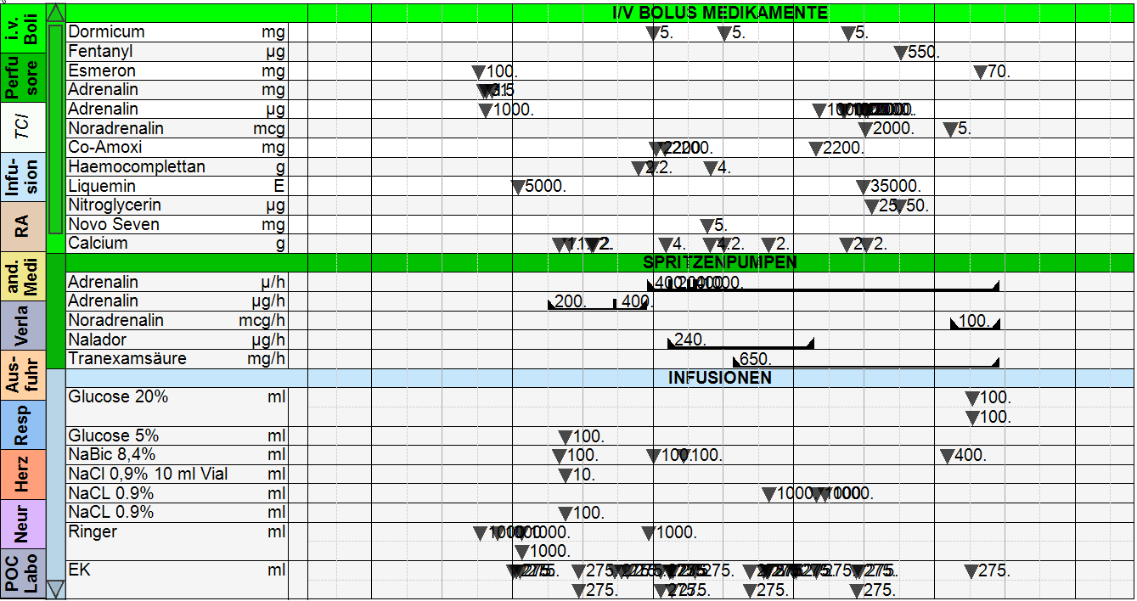

Slide 8

SARS-CoV-2 originated at Wuhan City, Hubei Province, China in early December 2019…

Slide 9

Hou L. et al., Heart&Lung 2021, DOI:10.1016/j.hrtlng.2020.08015

Slide 10
A 31 yo parturient, 35 weeks of gestation, developped a sore throat and cough after returning from Hubei Province on Jan. 27, 2020.
Admitted to hospital on Feb. 1. with a positive SARS-CoV-2 test
Emergency CS and ECMO placement at day 6
Survived without lesions

Slide 11

H1N1
SARS/MERS
SARS-CoV-2
Increasing incidence of elderly partiurients with preexisting cardiac disease
Increasing incidence of sepsis-related ARDS in parturients
Increasing expertise and caseload in non-obstetric ECMO

Slide 12
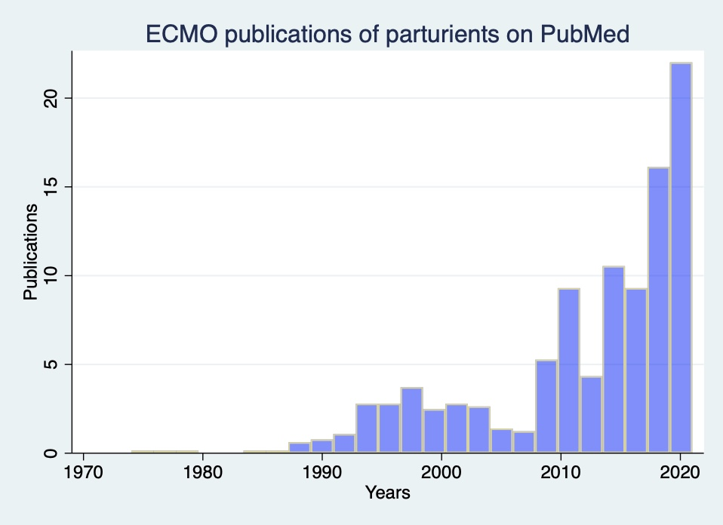
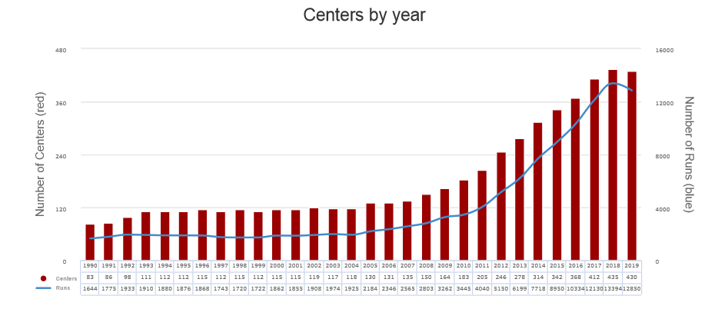
SARS-CoV-2
ELSO total ECMO numbers
EOLIA trial
H1N1
SARS

Slide 13


To review the literature…
Before Covid-19
During Covid-19

Slide 14

USA, Jan. 1999-October 2015, N= 83 ECMO in cohort of 15,3 million pregnancies
Healthcare Cost Utilization Project cohort, largest amount of US inpatient admission data
Sebastian N. et al, Archives of Gynecology and Obstetrics, 2020, DOI 10,1007/s00404-020-05530-5

Slide 15
Overall survival rate among pregnant women requiring ECMO was 62%
Sebastian N. et al, Archives of Gynecology and Obstetrics, 2020, DOI 10,1007/s00404-020-05530-5

Slide 16
International Extracorporeal Life Support Organization (ELSO) cohort analysis
N=280 from 1997-2017
Overall maternal survival was 70%
No mortality difference between VV and VA-ECMO, no mortality difference between pulmonary or cardiac indications
Increased survival after 2010
Ramanathan, K. et al, Critical Care Medicine, 2020, DOI: 10.1097/CCM.0000000000004269

Slide 17
Single center cohort:
University of Maryland,
Baltimore, USA
N=21, 2009-2019
Maternal survival was 72%
Neonatal survival was 100%
Lankford AS. et al., A&A, 2021, DOI: 10.1213/ANE.0000000000005266

Slide 18
ECMO-related complications:
33% with major bleeding
Pulmonary embolism limb ischemia

Slide 19

Finally the meta-regression analysis
Zhang, J.J et al., Journal of Intensive Care Medicine, 2019, DOI: 10.1177/0885066619892826

Slide 20
N=78
9 studies included in quantitative synthesis
Time range 1972-2017

Slide 21
Pooled prevalance of maternal survival:
77.2%
Zhang, J.J et al., Journal of Intensive Care Medicine, 2019, DOI: 10.1177/0885066619892826

Slide 22
Pooled prevalence of bleeding complications
38%
Zhang, J.J et al., Journal of Intensive Care Medicine, 2019, DOI: 10.1177/0885066619892826

Slide 23
Pooled prevalence of fetal survival rate: 69.1%
Zhang, J.J et al., Journal of Intensive Care Medicine, 2019, DOI: 10.1177/0885066619892826

Slide 24

Meanwhile the Delta variant arrived also in Switzerland the ICU-median with SARS-CoV-2 is 57 years old

Slide 25
Highly informal Email and Whatsapp
CH-survey
(Tanks to the respondents!)
Parturient patients in ICU's
Center | Intubated | on ECMO
Luzern | 3 | 1
Zürich | 5 | 1
Bern | 4 | 1
Geneva | 0 | 0
Winterthur | 0 | na.
Basel | 0 | 0
Lausanne | ? | ?
St. Gallen | 1 | 1
Sion | 2 | 0

Slide 26

SARS-CoV2
H1N1

Slide 27
UK Obstetric Surveillance System (UKOSS)
N=427 in between March 1st 2020 and April 14th. 2020
Conclusions:
Hospital admissions:
70% overweight or obese
40% aged 40 or over
33% with comorbidities
Overall mortality: 1/18’000 parturients
Critical care admission and mortality similar to
General population of reproductive age:
Of those who were admitted to hospital
20-30% recieve critical care and 1-4% die
Knight M. et al., BMJ 2020, DOI:10,1136bmj.m2107

Slide 28
Washington State, USA
Characteristics of 46 pregnant women with SARS-CoV-2
January 21. 2020 - April 17. 2020
N=46
6 hospital admissions, hereby
1 critical care admission
Risk factors:
  Age
  Overweight/obese
  Cardiovascular comorbidities
Lokken E. et al., Am J Obstet Gynecol 2020, DOI 10,1016/j.ajog.2020.05.031

Slide 29
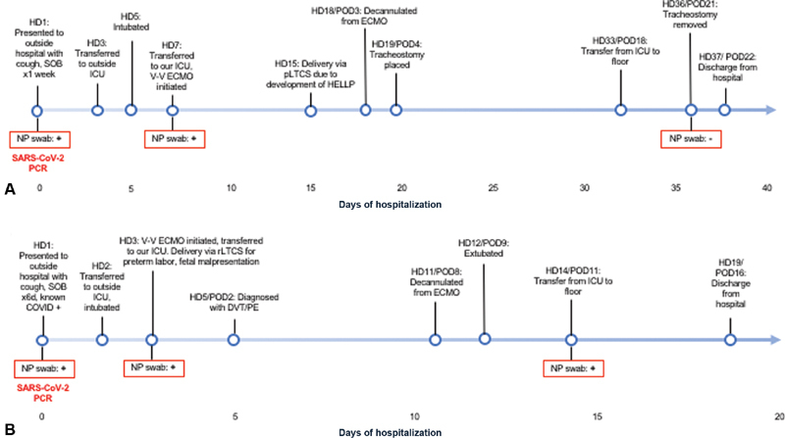
UCLA, CA, USA
Case series of 2 parturients on ECMO early 2020
Mother A: 27 yo African-American women with obesity
Mother B: 43 yo Filipino women with hypertension, diabetes mellitus and obesity
Douglass K. et al., Am J Perinatol 2021, DOI: 10.1055/s-0040-1718694

Slide 30
Meanwhile a snapshot in France
Survey of 33 maternities in France from March 1 to April 14, 2020
N= 617 with SARS-CoV-2
N (%)
Kayem G. et al., J Gynecol Obsttet Hum Reprod 2020, DOI 10.1016/j.jogoh.2020.101826

Slide 31
Kayem G. et al., J Gynecol Obsttet Hum Reprod 2020, DOI 10.1016/j.jogoh.2020.101826

Slide 32


Slide 33
Lessons learned and recommendations to keep in mind

Slide 34

Incidence rate of ECMO in pregnancy is 2.5/100’000 pregnancies/year (2015)
CH: approx. 86’000 live births/year (2020)
Main indications are cardiac or pulmonary failure
  VTE
  Pneumonia
  Sepsis, septic shock and other infectious conditions
  Acute respiratory failure
  Heart failure
In CH-Numbers outside SARS-CoV-2
1-2 parturients on ECMO/year

Slide 35
Lessons learned and recommendations to keep in mind
Critical cardiac or pulmonary diseases severe enough to necessitate ECMO are associated with an acceptable maternal and fetal outcome
Pooled maternal survival is 77,2%
Pooled fetal survival is 69,1%
No significant difference between VV or VA-ECMO, although lenght of ECMO is significantly higher in VV (pulmonary) ECMO
ECMO is a viable option for maternal salvage during critical illness
More studies are needed, N-Numbers in parturients are small
Zhang, J.J et al., Journal of Intensive Care Medicine, 2019, DOI: 10.1177/0885066619892826
Naoum E. et al., J Am Heart Assoc. 2020, DOI:10.1161/JAHA.119.016072

Slide 36

Thank’s for listening
The ECMO might be an arrow in the quiver of the OB Anesthesiologist…

Slide 37

Questions ?

